Slide 1
Strategic Plan 2022-2024

Slide 2
Mission:
To provide skills training, job development and social services to New Mexicans.
Vision:
New Mexicans will have the opportunity to improve their lives by utilizing Goodwill services and partnerships.

Slide 3
Values
Integrity
Take responsibility for your actions.
Acknowledge that the choices you make impact others.
Choose truth and honesty.
Respect
Treat others as you would like to be treated.
Value diversity in others.
Support others to take action to reach their full potential.
Excellence
Strive to reach your full potential.
Commit to continual improvement.
Act responsibly to create and maintain a safe working environment.

Slide 4
Enhance Mission Services
Enhance and expand mission services to provide intensive and impactful support to our communities.
Increase focus on our employees by providing greater opportunities for professional development and advancement.

Slide 5
Optimize Retail Performance
Maximize donation quality and quantity to improve inventory to fuel sales.
1
Optimize existing stores performance to meet or exceed targeted revenue.
2
Aggressively grow brick and mortar stores and e-commerce operations.
3

Slide 6
Drive Growth & Diversification
Focus on ensuring that we have the appropriate talent in place to fulfill our strategic plan.
Targeted Investments in our facilities, operations and technologies.
Collect and analyze data to drive informed decision making.
Expand sustainability efforts to increase profitability and make a positive impact on the environment.
Embrace creativity and community collaboration to bring our mission and culture alive in everything we do.

Slide 7
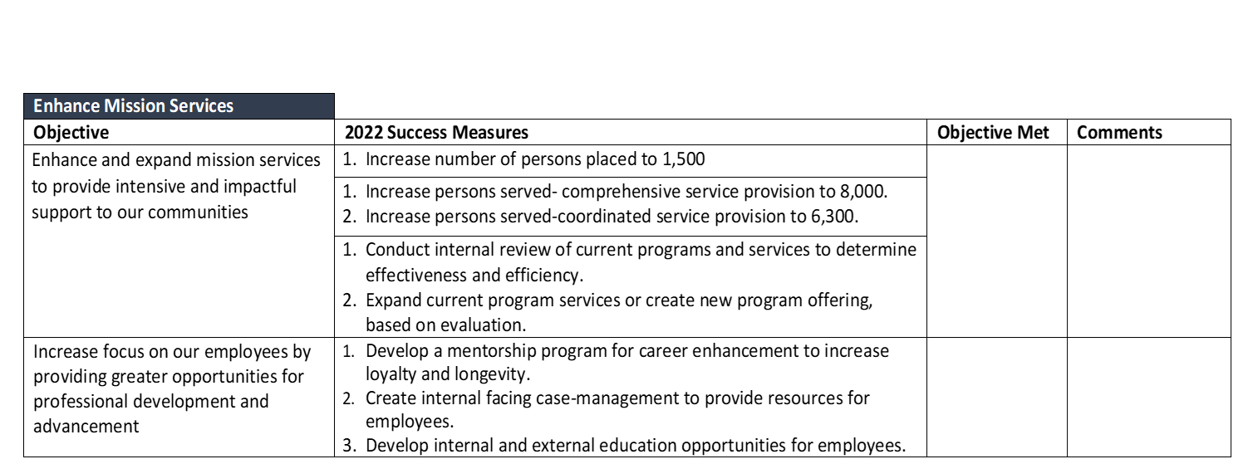
2022 Strategic Objectives

Slide 8
2022 Strategic Objectives

Slide 9
2022 Strategic Objectives
Drive Growth and Diversification
Objective | 2022 Success Measures | Objective Met | Comments
Focus on ensuring that we have the appropriate talent in place to fulfill our strategic plan | Identify key performance indicators (KPI) and benchmarks for HR; report metrics to the Board. Complete analysis of KPI’s to adjust staffing decisions, organizational structure and training needs.
Targeted investments in our facilities, operations and technologies | Complete an agency wide needs assessment on all facilities for technology, equipment, maintenance and capital improvements. Develop a three-to-five year plan for implementation.
Collect and analyze data to drive informed decision-making | Complete integration of new systems and identify key data points and metrics to drive decisions and optimize agency data in Services, Operations and Administration. (Quarterly data collection and analysis of program and business outcomes: ROBarT, CaseWorthy, Centage Create an internal dashboard for Senior Leadership.
Expand sustainability efforts to increase profitability and make a positive impact on the environment | Research and create parameters and a framework for proposed sustainability efforts. Implement two sustainability efforts that generate positive impacts and increase GINMs profitability through revenue generation, decrease in expenses or both.
Embrace creativity and community collaboration to bring our mission alive in everything we do | Develop GINM’s employee engagement efforts through meaningful interactions; demonstrate at least three initiatives. 18,000 points of service outreach statewide. Engage the community by telling our story through expanded marketing efforts, emphasizing our mission. Demonstrate a 20% increase in digital media impressions. Demonstrate a 20% increase in the number of followers on GINM’s social media networks.

